Slide 1
Workshop
Programming with C

Slide 2
Introduction to C Programming
Developed by Dennis Ritchie
Mainly developed as a system programming language to write operating system
C is a procedural programming language

Slide 3
Turbo C++

Slide 4
preprocessor
directive
#include <stdio.h>
#include <conio.h>
void main()
{
clrscr();
printf(“welcome to C Programming”);
getch();
}
Header File
Standard I/O
return type
function
Console I/O
main
function
block
Terminator
Formatted Printing
\n is used to move the control onto the next line
\t is used to give a horizontal tab i.e. continuous five spaces

Slide 5
Turbo C++ shortcuts:
F2 ➔ Save ➔ filename.c (c file must have .c extension)
Alt + F9 ➔ Compile (human readable code to machine readable code)
Ctrl + F9 ➔ Run (execute the program)

Slide 6
Question
Question:
Write a Program to print your name and address

Slide 7
Escape Characters
Symbol | Description
\n | New Line
\t | Horizontal tab
\v | Vertical Tab
\r | Carriage return*
\\ | \
\b | Backspace
* Move cursor to first position of a line

Slide 8
Program to Add two numbers
#include<stdio.h>
#include<conio.h>
void main()
{
int num1, num2, sum;
num1 = 10;
num2 = 20;
sum = num1 + num2;
printf(“sum is %d”,sum);
getch();
}
Variables
Data type
(integer)
Format specifier

Slide 9
Manual Input using scanf()
#include<stdio.h>
#include<conio.h>
void main()
{
int num1, num2, sum;
scanf(“%d%d”,&num1,&num2);
sum = num1 + num2;
printf(“%d + %d = %d”,num1, num2, sum);
getch();
}

Slide 10
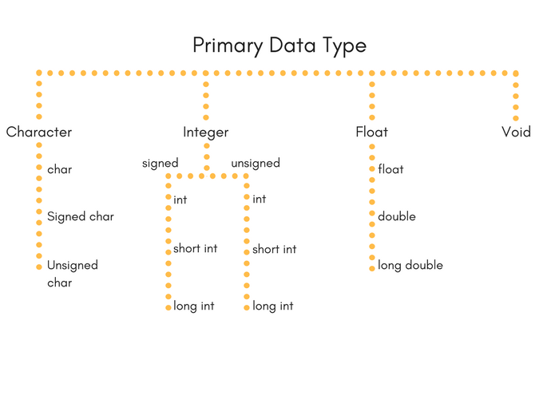
Data Types

Slide 11
Integer
Type | Size(bytes) | Range
int or signed int | 2 | -32,768 to 32767
unsigned int | 2 | 0 to 65535
short int or signed short int | 1 | -128 to 127
unsigned short int | 1 | 0 to 255
long int or signed long int | 4 | -2,147,483,648 to 2,147,483,647
unsigned long int | 4 | 0 to 4,294,967,295

Slide 12
Floating Point Type
Type | Size(bytes) | Range
Float | 4 | 3.4E-38 to 3.4E+38
double | 8 | 1.7E-308 to 1.7E+308
long double | 10 | 3.4E-4932 to 1.1E+4932

Slide 13
Character type
Type | Size(bytes) | Range
char | 1 | -128 to 127

Slide 14
Variables
Assignment Operator
int a = 10;
Data Type
Variable
Value

Slide 15
Format Specifier
Format specifier | Description | Supported data types
%c | Character | char unsigned char
%d | Signed Integer | short unsigned short int long
%e or %E | Scientific notation of float values | float double
%f | Floating point | float

Slide 16
Operators
An operator is a symbol which operates on a value or a variable. For example: + is an operator to perform addition.
num1 + num2
Operand
Operator

Slide 17
Operators
Arithmetic Operators
Increment and Decrement Operators
Assignment Operators
Relational Operators
Logical Operators
Bitwise Operators
sizeof Operator
Ternary Operator

Slide 18
Arithmetic Operator
+ ➔ Addition ➔ 2+2 returns 4
- ➔ Subtraction ➔ 2-2 returns 0
* ➔ Multiplication ➔ 2*2 returns 4
/ ➔ Division(Quotient) ➔ 5/2 returns 2
% ➔ Modulo(Remainder)➔ 5%2 returns 1

Slide 19
Increment and Decrement Operator
++ ➔ i++ same as i = i+1
-- ➔ i-- same as I = i-1

Slide 20
Assignment Operator
Operator | Example | Same as
= | a = b | a = b
+= | a += b | a = a+b
-= | a -= b | a = a-b
*= | a *= b | a = a*b
/= | a /= b | a = a/b
%= | a %= b | a = a%b

Slide 21
Relational Operator
Operator | Meaning of Operator | Example
== | Equal to | 5 == 3 returns 0
> | Greater than | 5 > 3 returns 1
< | Less than | 5 < 3 returns 0
!= | Not equal to | 5 != 3 returns 1
>= | Greater than or equal to | 5 >= 3 returns 1
<= | Less than or equal to | 5 <= 3 return 0

Slide 22
Logical Operator
Operator | Meaning of Operator | Example
&& | Logial AND. True only if all operands are true | If c = 5 and d = 2 then, expression ((c == 5) && (d > 5)) equals to 0.
|| | Logical OR. True only if either one operand is true | If c = 5 and d = 2 then, expression ((c == 5) || (d > 5)) equals to 1.
! | Logical NOT. True only if the operand is 0 | If c = 5 then, expression ! (c == 5) equals to 0.

Slide 23
Bitwise
Operators | Meaning of operators
& | Bitwise AND
| | Bitwise OR
^ | Bitwise exclusive OR
~ | Bitwise complement
<< | Shift left
>> | Shift right

Slide 24
Ternary Operator (?:)
conditionalExpression ? expression1 : expression2

Slide 25
Program to find greatest of two no.
#include<stdio.h>
#include<conio.h>
void main()
{
int a, b;
printf(“Enter two numbers”);
scanf(“%d%d”,&a,&b);
(a>b)?printf(“a is greater”):printf(“b is greater”);
getch();
}

Slide 26
Question
Write a program to check whether a number is positive or negative.

Slide 27
Control Statement
Selection
Iteration or loops

Slide 28
Selection
if statement
if…else statement
If…else if… else statement (ladder)
nested if
switch… case

Slide 29
If Statement
if (condition)
{
statements
}

Slide 30
Program to check number is positive
#include<stdio.h>
#include<conio.h>
void main()
{
int num;
printf(“enter any number”);
scanf(“%d”,&num);
if(num>0)
{
printf(“positive”);
}
getch();
}

Slide 31
If…else Statement
if (condition)
{
statements;
}else{
Statement/s;
}

Slide 32
Check positive or negative
#include<stdio.h>
#include<conio.h>
void main()
{
int num;
printf(“enter any number”);
scanf(“%d”,&num);
if(num>0)
{
printf(“positive”);
}

Slide 33
Continued..
else
{
printf(“negative”);
}
getch();
}

Slide 34
If…else if…else Statement
if(condition1)
{
// statement(s);
}
else if(condition2)
{
//statement(s);
}
………
else
{
//statement(s);
}

Slide 35
Check positive zero and negative
#include<stdio.h>
#include<conio.h>
void main()
{
int num;
printf(“enter any number”);
scanf(“%d”,&num);
if(num>0)
{
printf(“positive”);
}

Slide 36
Continued..
else if(num==0)
{
printf(“Zero”);
}
else
{
printf(“negative”);
}
getch();
}

Slide 37
Question
Write a program to compare two numbers…
if the number is even or Odd

Slide 38
Switch
switch( expression )
{
case constant-expression1:
statements1;
break;
case constant-expression2:
statements2;
break;
case constant-expression3:
statements3;
break;
default :
statements4;
}

Slide 39
Switch example:
#include<stdio.h>
#include<conio.h>
void main()
{
int num;
printf(“Enter a day number”);
scanf(“%d”,&num);
switch(num)
{
case 1:
printf(“Sunday”);
break;
case 2:
printf(“Monday”);
break;

Slide 40
Continued..
case 3:
printf(“Tuesday”);
break;
case 4:
printf(“Wednesay”);
break;
case 5:
printf(“Thursday”);
break;
case 6:
printf(“Friday”);
break;
case 7:
printf(“Saturday”);
break;
default:
printf(“Invalid day”);
}
getch();
}

Slide 41
Loops
Entry Controlled | Exit Controlled
while for | do…while

Slide 42
while
while(condition)
{
Statement/s
}

Slide 43
While
int n, i=1;
clrscr ();
printf ("enter the values of n");
scanf ("%d", &n);
printf ("natural numbers from 1 to %d ", n);
while (i<=n)
{
printf ("%d\ t", i);
i++;
}

Slide 44
for
for(Initializtion;Condition;Updation)
{
Statemant/s;
}

Slide 45
for
int n,i;
clrscr();
printf("enter any number");
scanf("%d",&n);
for(i=1,i<=n,i++)
{
printf(“%d”,i);
}

Slide 46
do…while
do
{
Statement/s;
}while(condition);

Slide 47
do…while
int n,i=1;
clrscr();
printf("enter any number");
scanf("%d",&n);
printf("natural numbers from 1 to %d",n);
do
{
printf("%d\t",i);
i++;
}while(i<=n);

Slide 48
Print multiplication table of any numbers from 1 to 20

Slide 49
Thank You

Slide 50
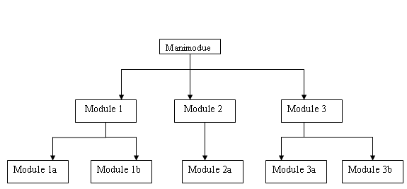
Function

Slide 51
Function
We have 2 types of functions:
Standard library functions
User-defined functions

Slide 52
Function
Function declaration
Function calling
Function definition

Slide 53
Function
return type function_name(argument list) { code block; }

Slide 54
Function
#include < stdio.h>
#include < conio.h>
void speakHello(); /* Function Declaration */
void main()
{
clrscr();
speakHello(); /* Function Calling */
getch();
}
void speakHello() /* Function Definition*/
{
printf("\n WELCOME TO THE WORLD OF C LANGUAGE");
}

Slide 55
Function –return statement
#include < stdio.h>
void speakHello(int, int); /* Function Declaration */
void main()
{
clrscr();
printf(“%d”, speakHello(12,21)); /* Function Calling */
getch();
}
void speakHello(int x, int y) /* Function Definition*/
{
return (x+y);
}

Slide 56
Array
type variable_name[lengthofarray];
int min[9];

Slide 57
Array
int min[5];
45 | 56 | 89 | 11 | 22
min[0]
min[1]
min[2]
min[3]
min[4]
CONTINOUS MEMORY LOCATIONS

Slide 58
Array
int myArray[5] = {1,2,3,4,5};
for (int i=0;i<5;i++){
printf("%d", myArray[i]);
}

Slide 59
Question
Find the greatest number in an array

Slide 60
Array – Multidimensional
int values [3] [4]
Size: 3x4 = 12
[0,0] | [0,1] | [0,2] | [0,3] | [0,4]
[1,0] | [1,1] | [1,2] | [1,3] | [1,4]
[2,0] | [2,1] | [2,2] | [2,3] | [2,4]

Slide 61
Array – Multidimensional
int values [3] [4] = {
{
1, 2, 3, 4
}
{
5, 6, 7, 8
}
{
9, 10, 11, 12
}
};
Size: 3x4 = 12

Slide 62
Pointers
pointer is a variable that contains an address which is a location of another variable in memory

Slide 63
Pointers
Datatype *pointer name
int *p
The asterisk (*) tells the variable ‘p’ is a pointer variable.
‘p’ needs a memory location.
‘p’ points to a variable of type datatype.

Slide 64
Pointer
int a=10;
int *b;
b=&a;
printf("value of a=%d \n",a);
printf("value of a=%d \n",*(&a));
printf("value of a=%d \n",*b);
printf("address of a=%u \n",&a);
printf("address of a=%u \n",b);
printf("address of b=%u \n",&b);
printf("value of b=address of a=%u \n",b);

Slide 65
Pointer- Arithmetic
int main()
{
int m = 5, n = 10, o = 0;
int *p1;
int *p2;
int *p3;
p1 = &m; //printing the address of m
p2 = &n; //printing the address of n
printf("p1 = %d\n", p1);
printf("p2 = %d\n", p2);
o = *p1+*p2;
printf("*p1+*p2 = %d\n", o);//point 1

Slide 66
Pointer- Arithmetic
p3 = p1-p2;
printf("p1 - p2 = %d\n", p3); //point 2
p1++;
printf("p1++ = %d\n", p1); //point 3
p2--;
printf("p2-- = %d\n", p2); //point 4
//Below line will give ERROR
printf("p1+p2 = %d\n", p1+p2); //point 5
return 0;
}

Slide 67
Thank You

